Slide 1
A Daily Expense Tracker With Budget Alerts
WalletWise
Name: T.Lavanya
Reg: 192224039
Dept : AI & DS

Slide 2
Product Overview
Problem Statement
Many individuals struggle to consistently track their daily expenses.
Lack of timely budget alerts often results in overspending and financial stress.
Existing financial management tools are complex and not user-friendly for everyday use.
Most available apps lack real-time notifications and seamless support for iOS.
Solution
A simple and user-friendly iOS app for effortless daily expense tracking.
Real-time monitoring of spending to give users instant visibility.
Timely budget alerts to prevent overspending.
Personalized insights and summaries to improve financial decision-making.

Slide 3
Product Domain Study
SUMMARY
With rising living costs and increasing digital spending, managing personal finances is more important than ever. There’s a growing demand for a simple, effective iOS app that helps users track daily expenses, set budgets, and receive alerts—empowering them to stay in control of their money and build better financial habits.The app caters to students, working professionals, and families who need an intuitive tool to monitor their spending. It also promotes financial discipline by offering insights into spending patterns and encouraging smarter choices.
Article Link:
https://www.linkedin.com/pulse/how-build-personal-finance-app-from-scratch-2025-shivtechnolabs-dnptf

Slide 4
Problem Statement
Deepthi is a budget-conscious individual who needs a simple and reliable way to track her daily expenses because she values financial stability, wants to avoid the stress of overspending, and prefers using an intuitive, technology-driven solution to manage her money effortlessly. She often finds traditional expense tracking methods time-consuming and confusing, which discourages her from maintaining consistency. By using a smart app with real-time budget alerts, she can stay in control of her spending, save more effectively, and achieve her financial goals with confidence.

Slide 5
Project Scope
👤 My role:
As the Developer for the Daily Expense Tracker with Budget Alerts App, I am responsible for overseeing the design, development, and implementation of the app’s features that enable simple expense tracking, real-time budget monitoring, and user-friendly financial management experiences.
🔲 Responsibilities:
Conducting user research to understand spending habits, budgeting challenges, and user needs.
Creating paper and digital wireframes to visualize app layouts and user flows for expense entry, category management, and budget alerts.
Developing low and high-fidelity prototypes to showcase features like real-time notifications, budget insights, and expense summaries.
Implementing secure backend integration to ensure safe data storage and real-time synchronization.
Conducting usability testing to refine app design, improve ease of use, and enhance user satisfaction.

Slide 6
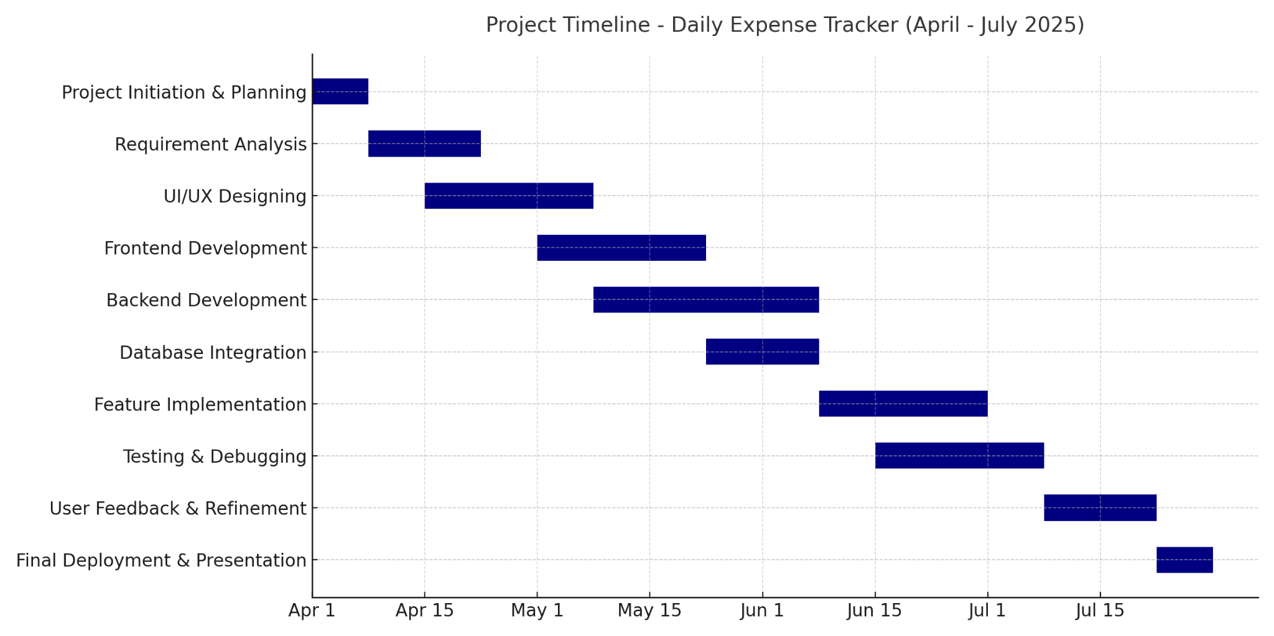
Project Plan

Slide 7
PROJECT TIMELINE
TASK | DESCRIPTION | START DATE | END DATE | DURATION
CONCEPT DEVELOPMENT | Define the app's purpose, target audience, and features. | April 3 | April 10 | 1 week
RESEARCH & DEVELOPMENT | Study user needs, industry-specific requirements, and technologies to build a practical, scalable solution. | April 11 | May 11 | 1 Month
TESTING & VALIDATION | Conduct usability tests to refine features, ensure accuracy in feedback, and validate. | May 12 | May 22 | 10 Days
PRODUCTION & LAUNCH | Deploy the app and make it accessible to users. | June 1 | June 15 | 15 Days
POST-LAUNCH EVALUATION | Collect user feedback, monitor performance, and implement updates. | June 20 | July 10 | 20 Days

Slide 8

USER PERSONA 1
Name: Harini
Age: 20
Occupation: Student
Income: 20,000
Lifestyle: Social, budget-conscious, busy balancing work and personal finances, prefers using apps to stay organized and save money effortlessly
PROBLEM:
While she values staying financially responsible, his busy lifestyle makes it hard to consistently track daily expenses and monitor his budget.
She struggles to categorize spending properly, leading to overspending in some areas without realizing it.
Frequently misses budget limits because she doesn’t get timely alerts, resulting in financial stress and difficulty saving money.
GOALS:
Offer clear visual summaries and spending insights for better financial awareness.
Help users set and achieve savings goals by monitoring and suggesting adjustments.
FRUSTATION:
Difficulty in tracking and categorizing expenses , which leads overspending.
Lack of timely budget alerts, causing him to miss limits and experience stress.

Slide 9
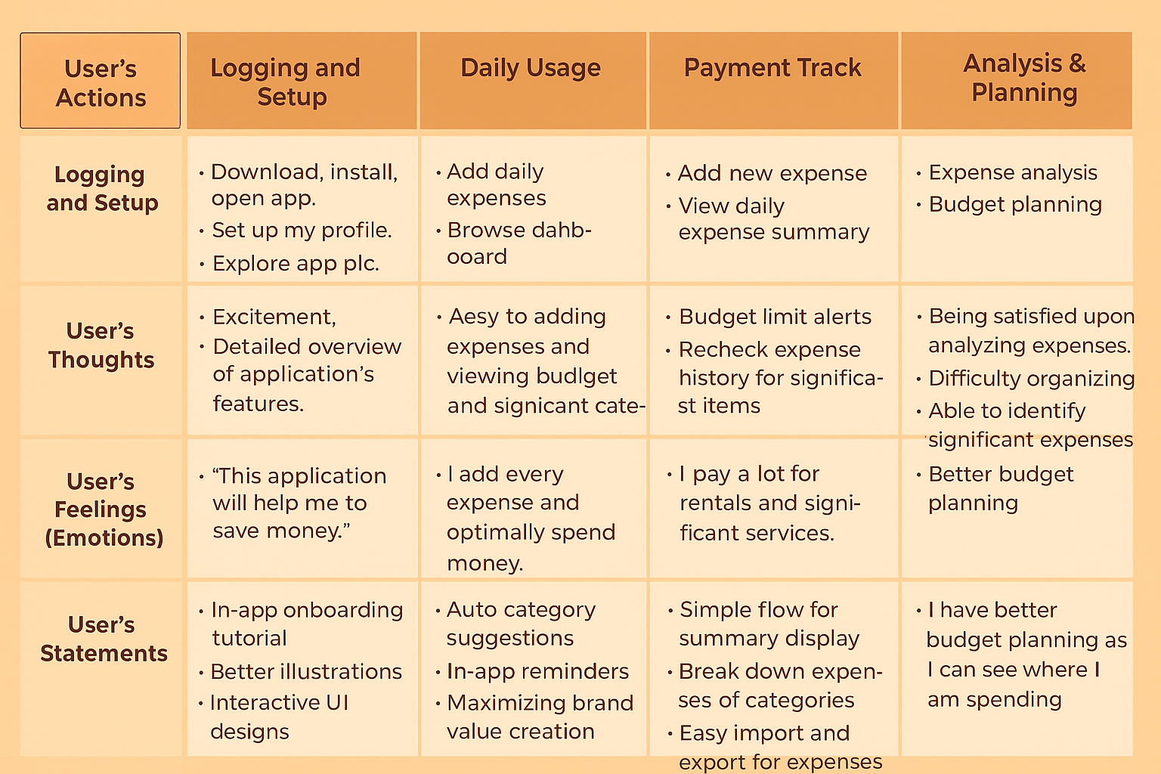
User Journey Map

Slide 10
COMPETITIVE ANALYSIS
Competitive Analysis
COMPETITOR | FEATURE SET | USER EXPERIENCE | PRICE | STRENGTHS | WEAKNESSES
MINT | Expense Tracking | Easy to use | Free | Simple to Use it | Lacks in Categorizations
YNAB | Budgeting and Goal Setting | Moderate | Free/$ | Helps to set budget goals | Limited in Statistics
POCKETGUARD | Payments,Alerts | User-friendly | Free | Helps in Alerts for spending | Lacks in summary
GOODBUDGET | Payment tracking | Easy | Free | Popular for money transfers | Doesn't handle rent scheduling
WALLY | Alerts and syncing | Flexible | Free/$ | Great for Syncing the data | Not tailored Budget Goals

Slide 11
Business Potential
GAP ANALYSIS
Existing tools are often complex, lack real-time alerts, and fail to help users categorize expenses effectively. This gap leads to overspending and poor budget control. The Daily Expense Tracker with Budget Alerts fills this gap by providing simple tracking, smart notifications, and easy categorization to help users stay financially disciplined.
TARGET AUDIENCE
The target audience includes students, professionals, and families who want an easy way to track daily expenses.
They seek simple tools with real-time budget alerts to avoid overspending and achieve financial stability.
UNIQUENESS
Provides real-time budget alerts with simple expense tracking in an intuitive iOS app, combining ease of use with smart financial insights.
MARKET SIZE
Most expense tracker apps range between ₹400–₹1,200 per month or ₹4,000–₹8,000 annually for premium features.
SOURCE:STSTISTICA:2024
Most expense tracker apps are priced between ₹400–₹1,200 per month or ₹4,000–₹8,000 annually.
Source: Statista, 2024

Slide 12
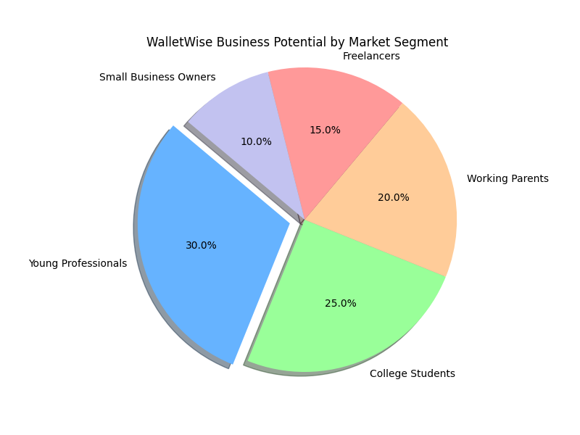
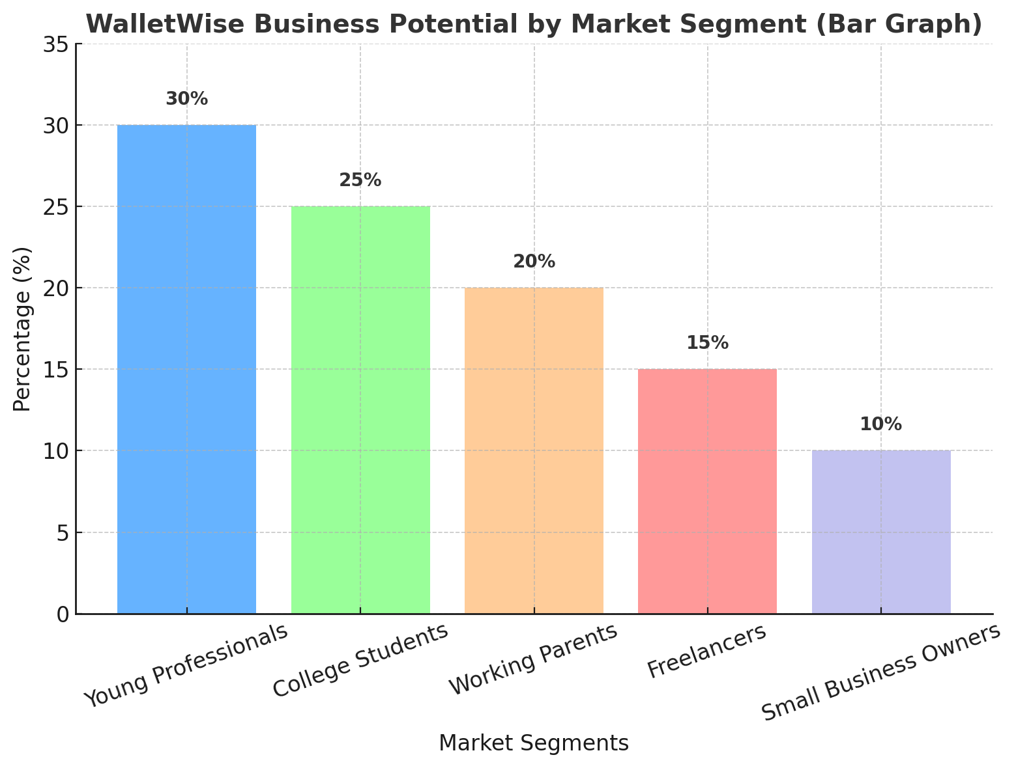
Business Potential

Slide 13
User Pain Points
1.Difficulty in Tracking Expenses
Users struggle to consistently record and monitor their daily spending, leading to incomplete financial awareness.
2. Lack of Timely Alerts
Without instant budget notifications, users often overspend unknowingly and cross their financial limits.
3. Complex Existing Tools
Most available apps are cluttered or complicated, discouraging regular usage for simple expense management.
4. Poor Categorization
Inability to categorize expenses easily makes it hard for users to analyze spending patterns and control budgets.

Slide 14
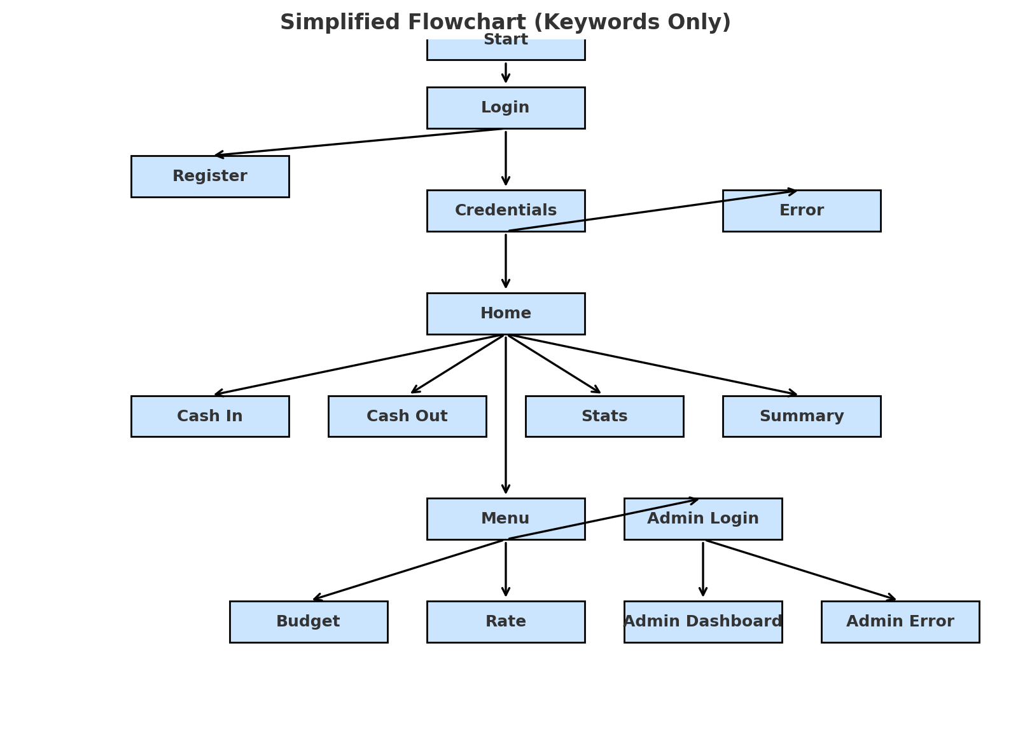
Flow Diagram

Slide 15
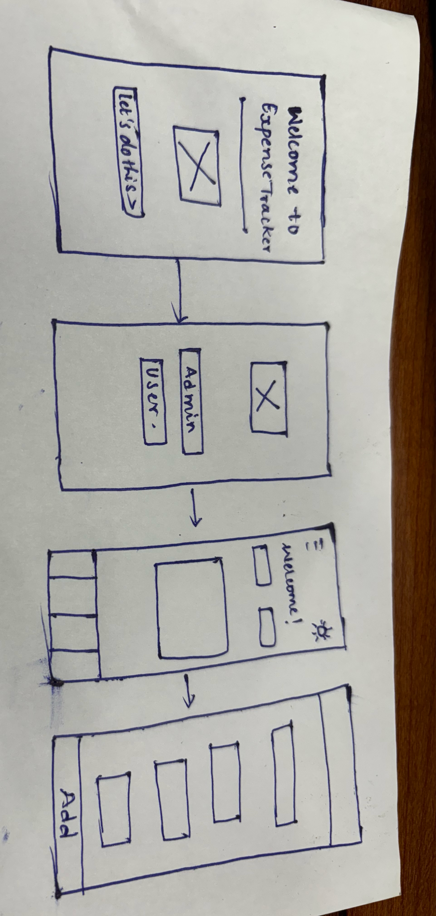
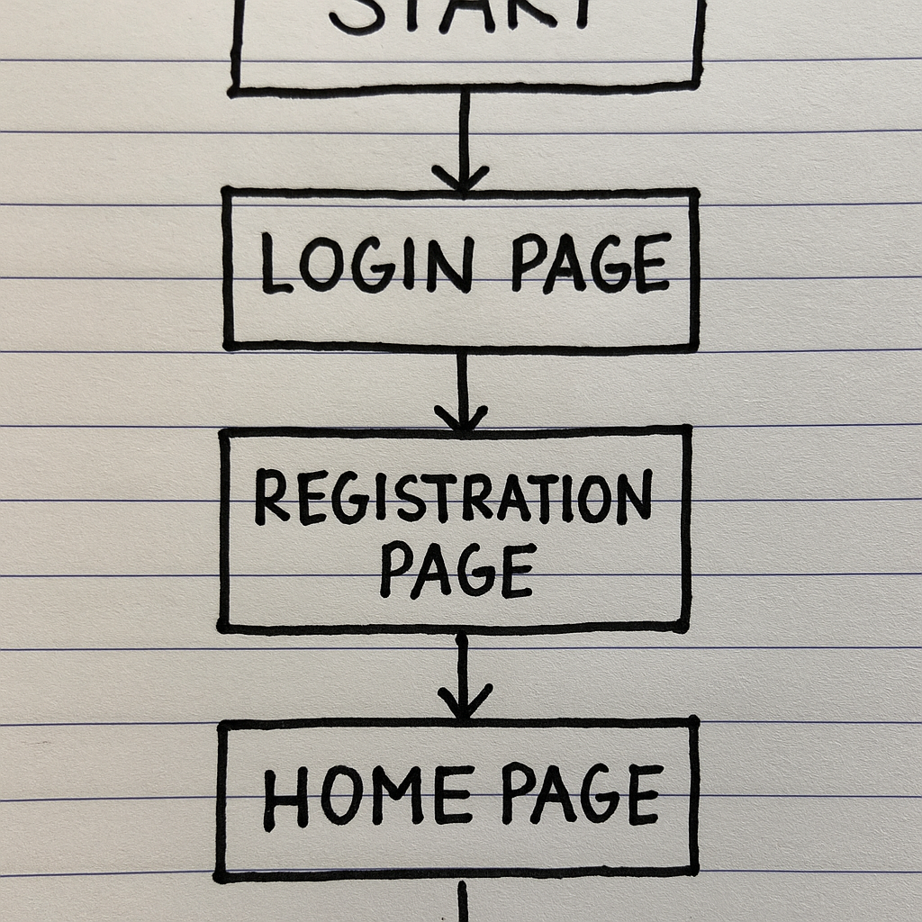
Product Sketches
PAPER WIREFRAMES

Slide 16
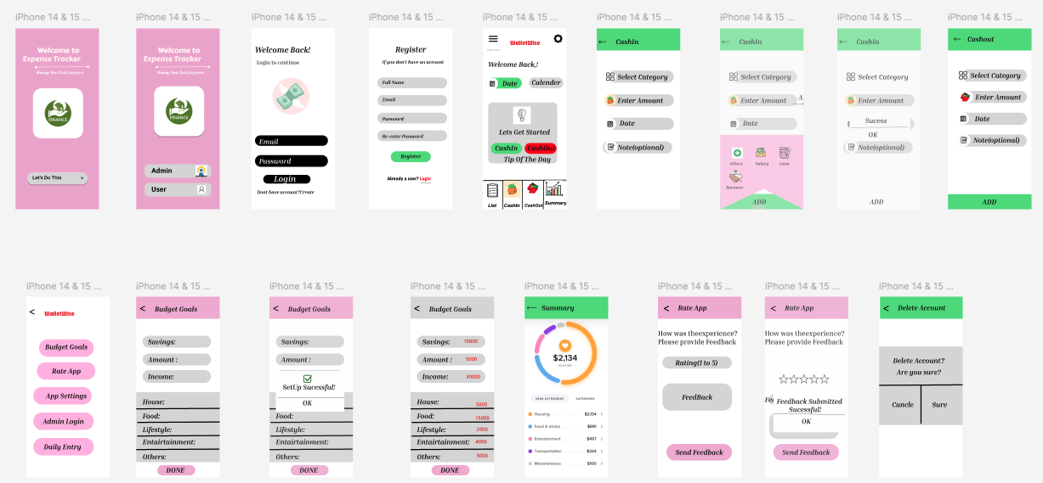
Ideation Sketches

Slide 17
TECH STACK
Layer | Technology Used | Purpose/Description
Frontend (iOS App) | SwiftUI | User interface, navigation, and app design
Backend | PHP 8.2 | Server-side logic, API handling
Database | MySQL (WalletWise DB) | Storing user data, expenses, budgets, and feedback
Server | XAMPP (Apache) | Local server environment for development & testing
Hosting (optional) | AWS / cPanel / DigitalOcean | Deployment and live hosting of backend & database
Authentication | PHP Sessions / JWT (JSON Web Token) | Secure login & session management
Notifications | Firebase Cloud Messaging (FCM) (optional) | Push notifications for budget alerts
Version Control | Git & GitHub | Code management & collaboration

Slide 18
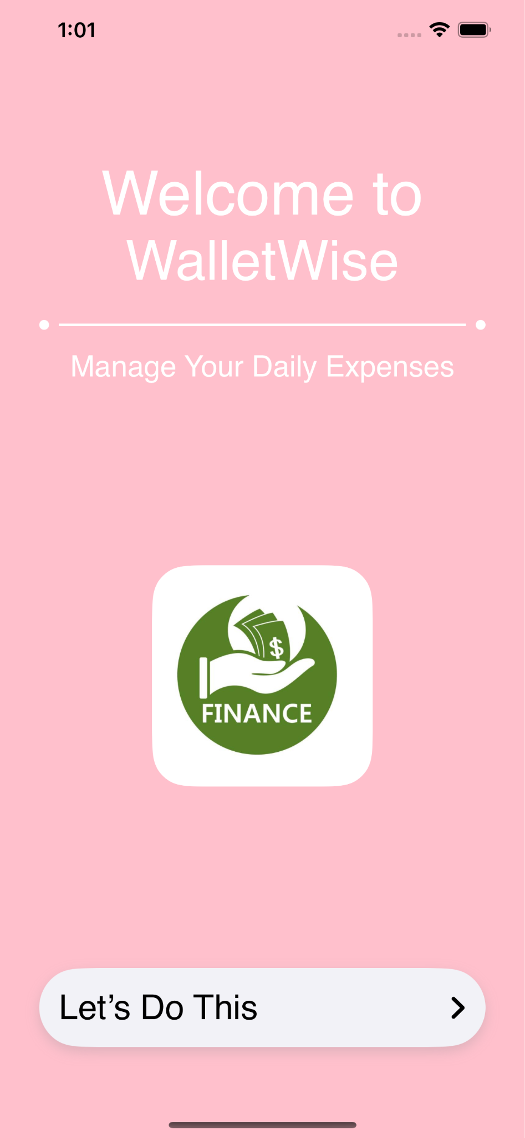
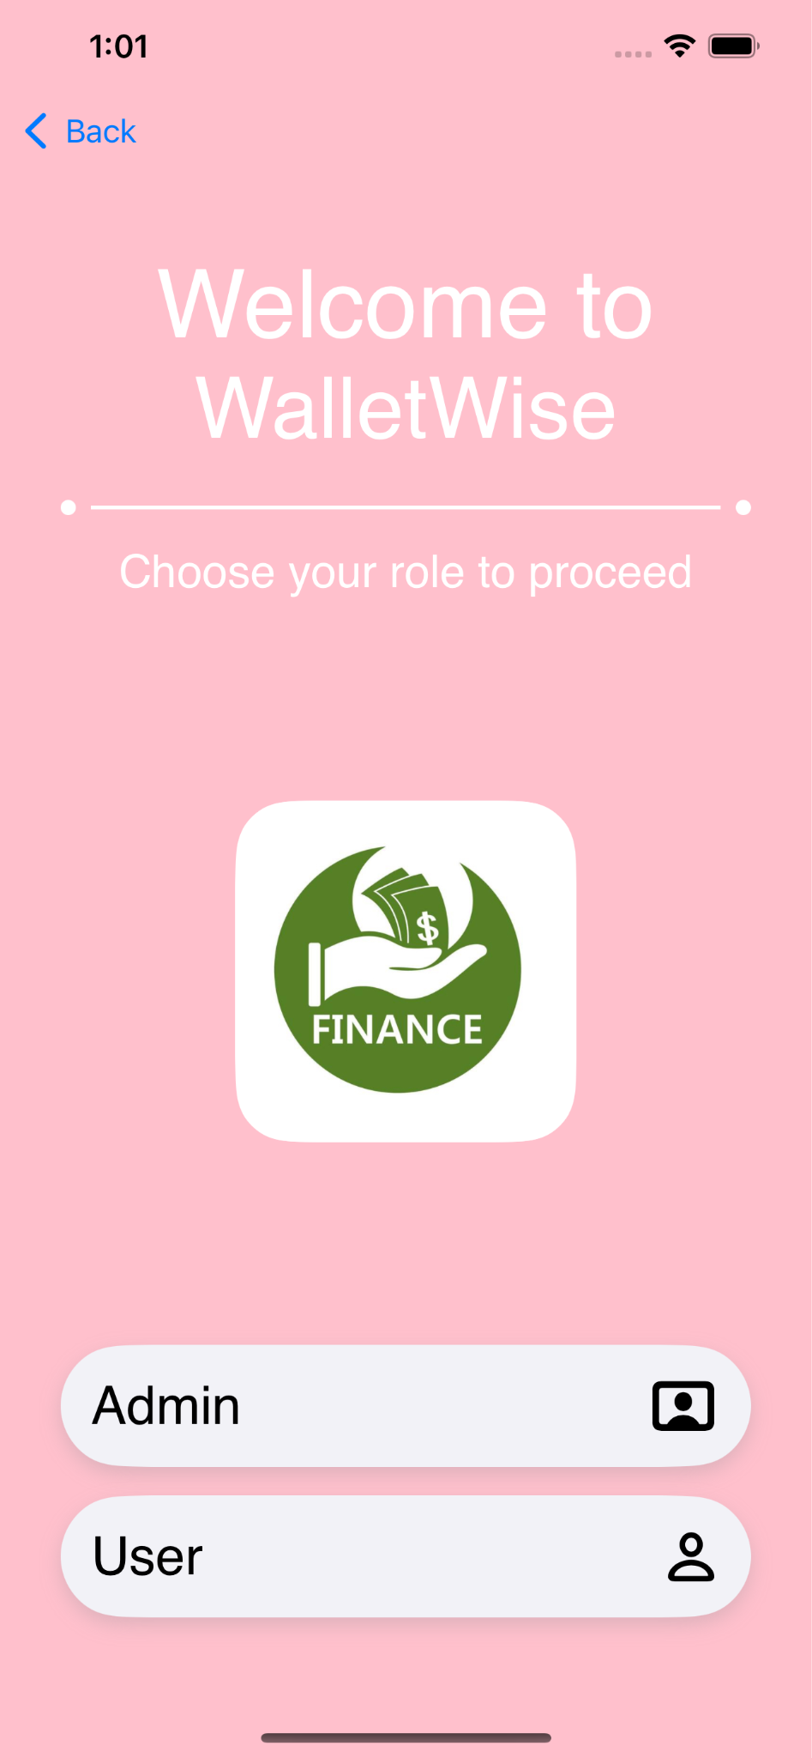
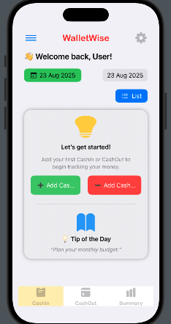
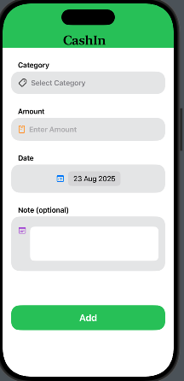
Design

Slide 19
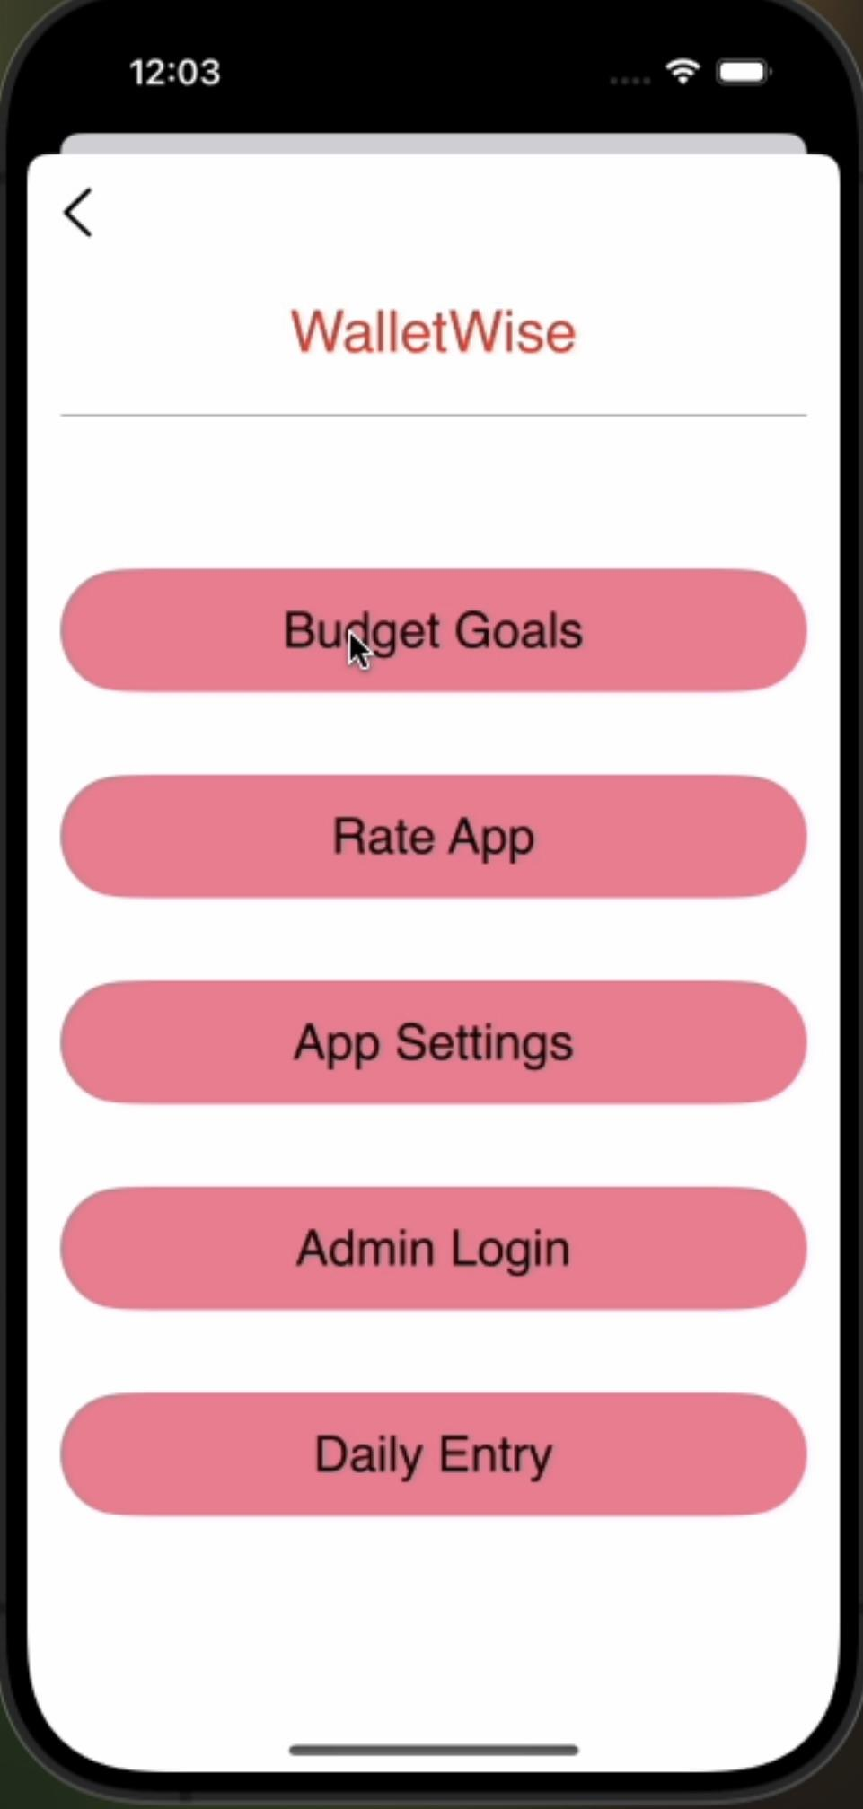
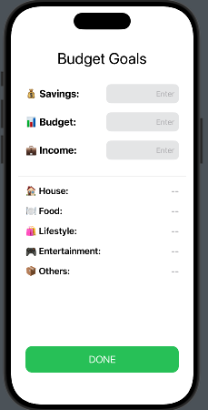
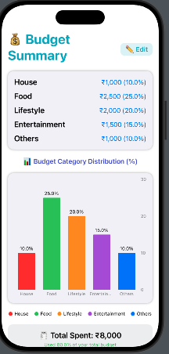
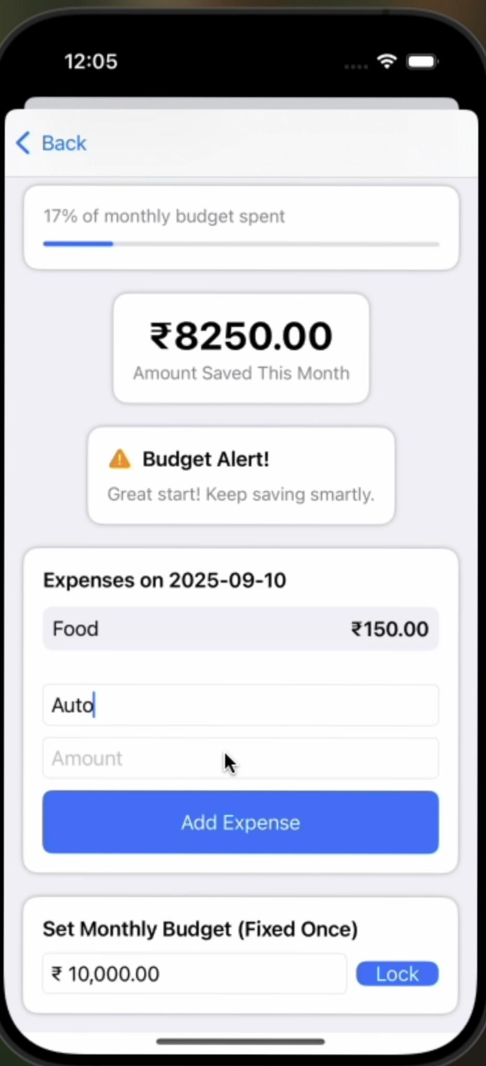
DESIGN

Slide 20
Project Learning
Project Impact
This project provides users with a simple yet effective tool to track daily expenses, receive timely budget alerts, and analyze their spending habits.
By addressing the common challenges of overspending and lack of awareness, the app promotes financial discipline and stress-free money management.
It also fills the gap left by many existing tools that are either too complex or lack real-time notifications, making it especially impactful for iOS users who prefer convenience and reliability.
What I Learned
Through this project, I developed strong technical skills in building a complete application using SwiftUI for the frontend and PHP with MySQL for the backend.
I learned how to design and manage databases efficiently, implement authentication and notifications, and ensure smooth integration between different layers of the tech stack.
Beyond technical aspects, I also improved my understanding of user needs, UI/UX principles, and testing standards to deliver a practical and user-friendly solution.
Additionally, I gained experience in project documentation, requirement analysis, and end-to-end development, which will help me in future professional projects.

Slide 21
PATENT
Unique Features:
Auto-Categorization of Expenses: Uses AI/ML to recognize and categorize expenses instantly without manual tagging.
Smart Budget Analysis: Predicts overspending and recommends adjustments.
Spending Pattern Analysis: Offers real-time daily and weekly visual insights.
Reminders and Notifications: Alerts for unusual spending or near budget limits.

Slide 22
NEXT STEPS
Step A: Finalizing Product Design and Features
Define and finalize core features including daily expense input, budget creation, real-time alerts, spending insights, and custom categories. Confirm the tech stack (Swift, Core Data)
Step B: Development and Iteration
Begin coding the iOS front-end interface and back-end data management systems.
Implement features for expense logging, budget calculations, real-time alert notifications, and spending categorization securely and efficiently.
Integrate third-party APIs for push notifications, data syncing, and optional payment or banking services.
Step C: Usability Testing and Refinements
Conduct extensive usability testing with a diverse group of users to uncover any usability issues or pain points.
Fix bugs, improve UI/UX elements, and optimize app performance based on test results.
Gather detailed feedback on features, responsiveness, and overall user satisfaction to guide final improvements.

Slide 23
ISO CODES
ISO CODES
Step D: Compliance and Industrial Approval
ISO 9001: Quality Management Systems: Ensure the app follows ISO 9001 standards for software quality, focusing on delivering a consistent, high-quality product.
ISO 27001: Information Security: Implement ISO 27001-compliant practices to ensure the secure handling of users’ personal data and payment information.
IEEE 29119: Defines best practices for thorough and effective software testing.
WCAG 2.1: Guides accessibility features to support users with disabilities.
WCAG 2.0: Ensures inclusive design for equal access by all users, including those with disabilities.

Slide 24

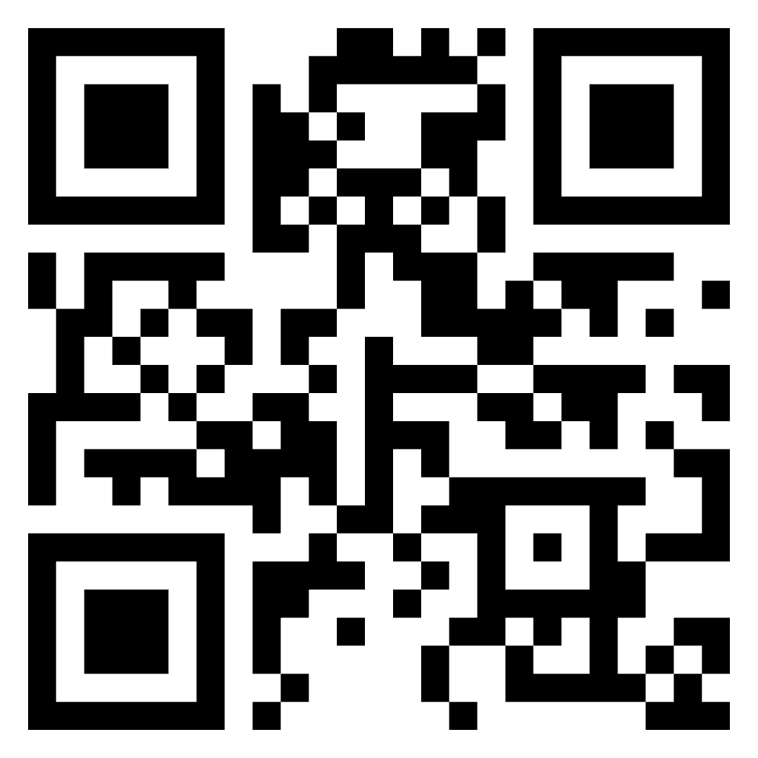

Thank you!
Let’s Connect
email:lavanyat4039.sse@saveetha.com
Walletwise.app
Linkdln:linkedin.com/in/tatiparthi-lavanya

